Slide 1
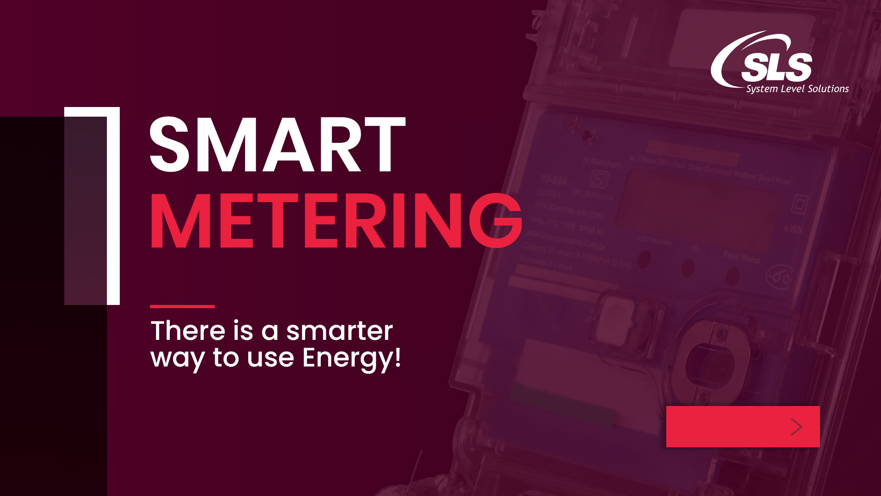

Slide 2

About SLS
We are a
Product & Service Company
Into
Hardware and Software
Established as a
Turnkey Solution Provider
100 +
300 +
21 +
Active projects across the globe
In-house staff
Years and counting
Operating Basis: India, UK, USA
No. Of Business Verticals: 7 +
No. Of Manufacturing Plants: 2
In-House Design & Manufacturing capability
Part of Make-in-India Initiative

Slide 3
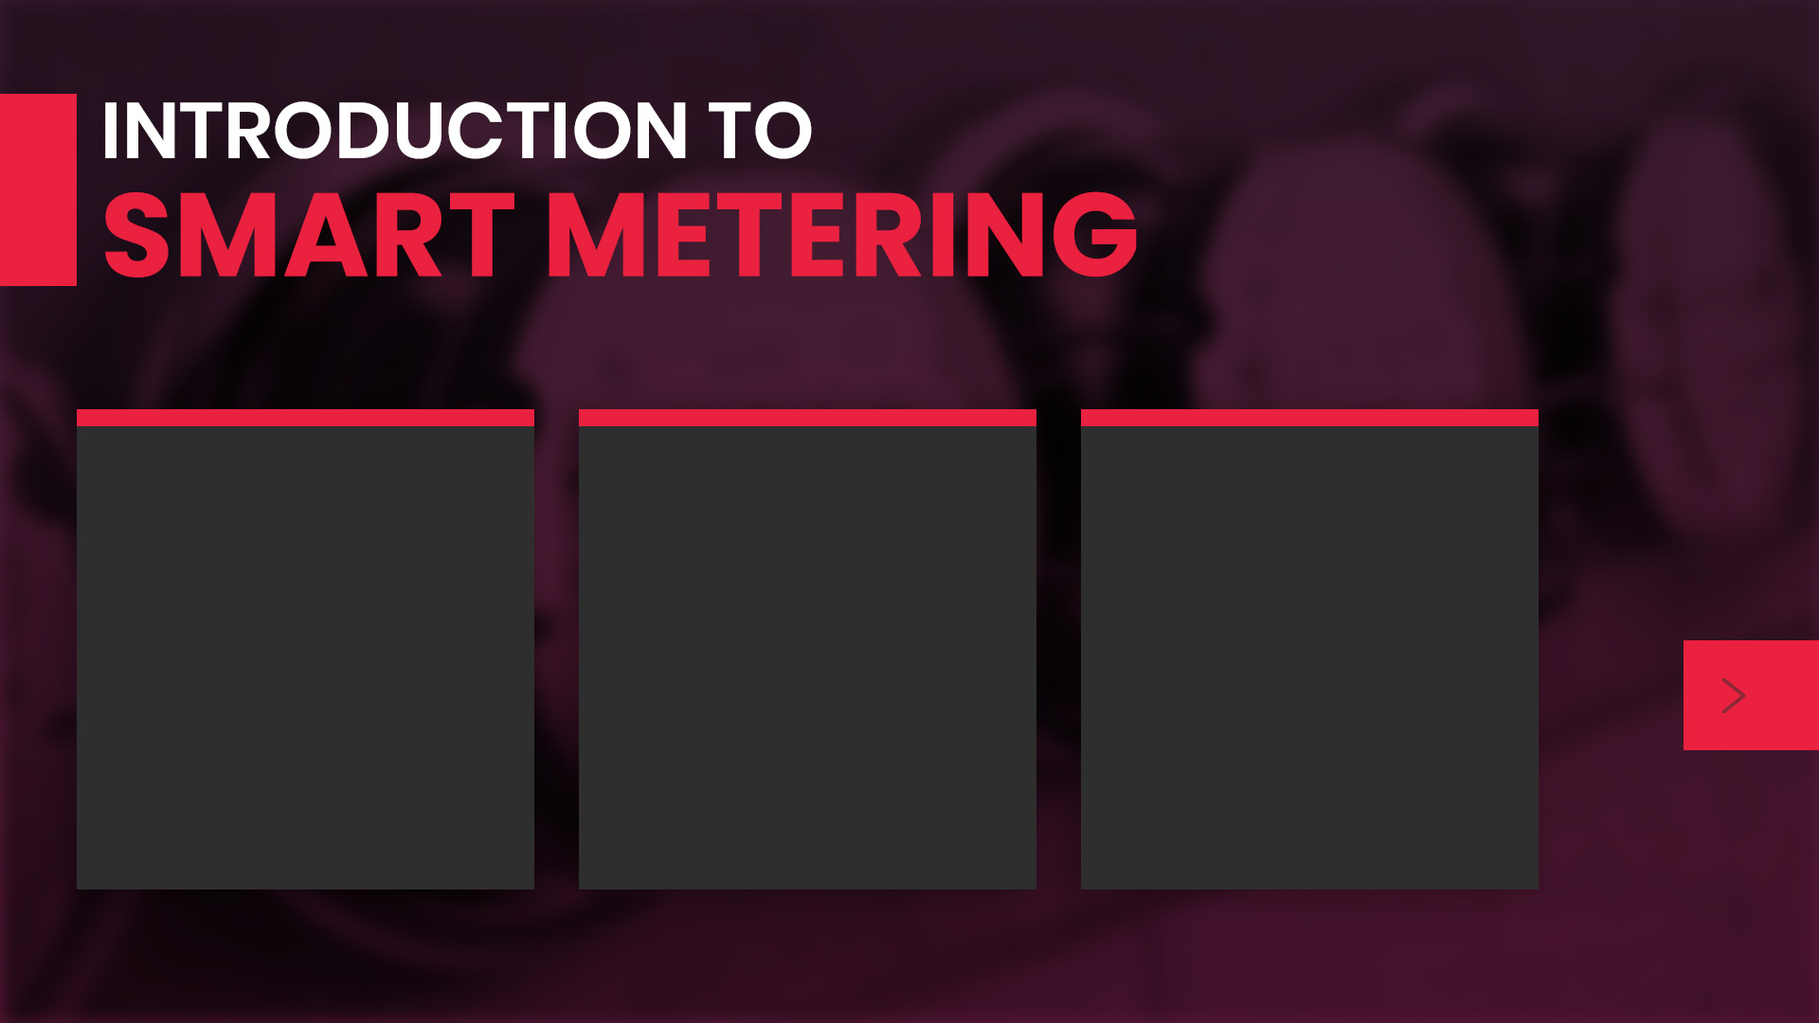
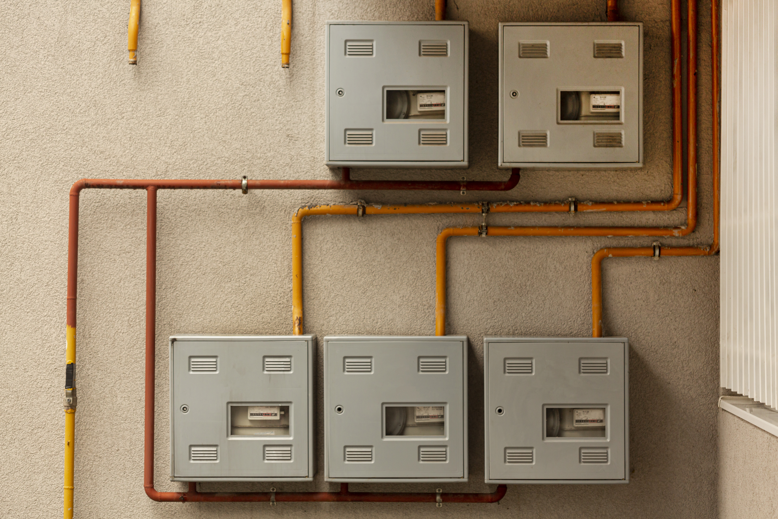


Electricity Metering
Gas Metering
Water Metering

Slide 4

Hardware Offerings
Wi-SUN Protocol
  AMI
  Module
  DCU
LoRaWAN Protocol
  AMR
  Module
  DCU
Software Offerings
LoRaWAN Network Server (LNS)
Network Management Server (NMS)
Head End System (HES)

Slide 5

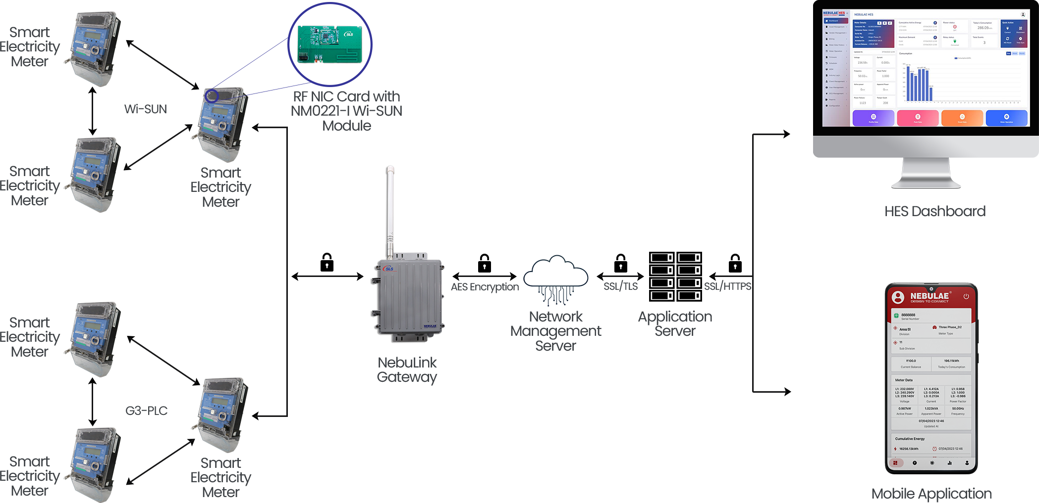
Energy AMI Architecture

Slide 6

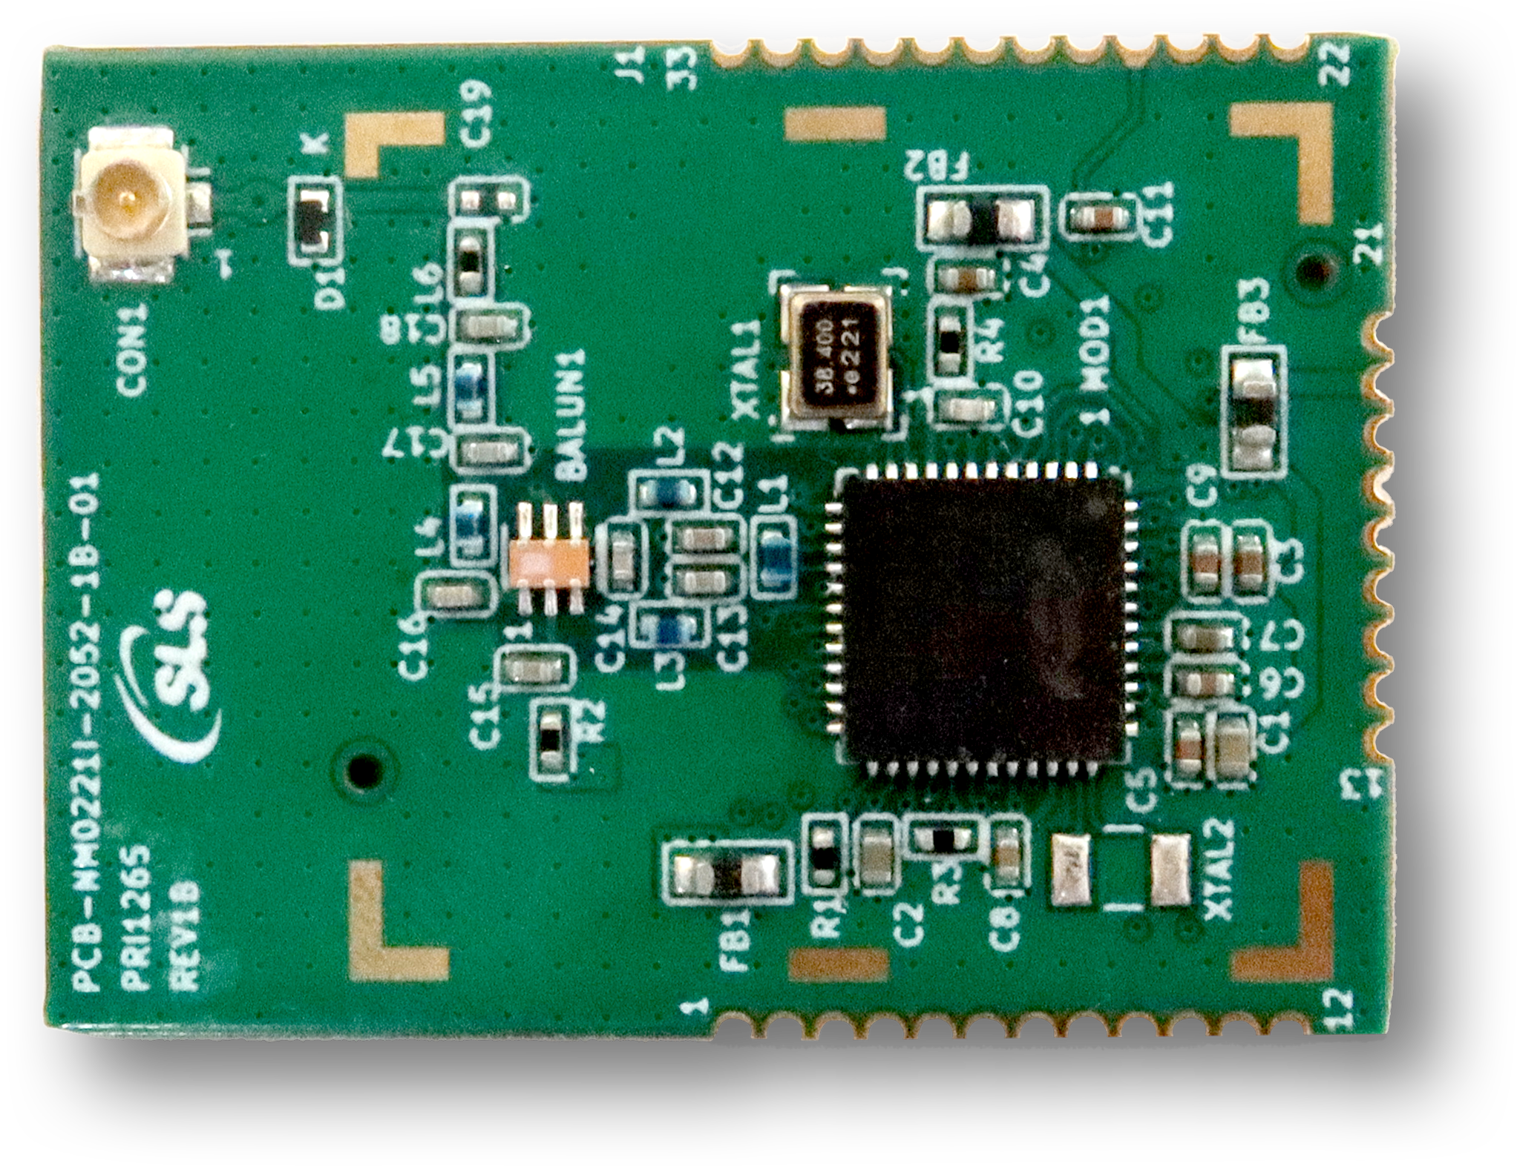
Wi-SUN Module
NM0221-I is a SOC-based low-power wireless module by Nebulae that provides long-range connectivity for IoT devices. NM0221-I is ideal for applications which need self-forming and self-healing mesh networks. The module is ideal for IS16444 smart metering applications because it is equipped with sufficient memory and is WPC certified. NM0221-I's FOTA capability makes it suitable for remote security updates.
FEATURES
Frequency band: 863 MHz to 876 MHz
Up to 1024 kB Flash program memory & 128 kB RAM data memory
Supports BPSK / DBPSK TX modulation format
32-bit real time counter and calendar
2 × Watchdog timer with dedicated RC oscillator
IEEE 802.15.4 compliant
12-bit 1 MSPS SAR analog to digital converter (ADC)
Provides an OTA (Over the Air) firmware update mechanism
Comes with U.FL connector to support external antenna

Slide 7
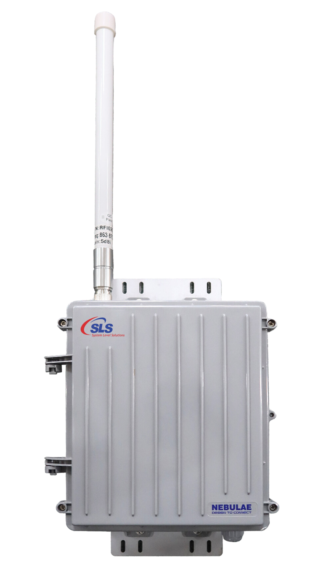
Wi-SUN DCU
The NLG8520 by Nebulae is a cutting-edge Wi-SUN gateway that provides secured interconnection of Wi-SUN field devices with WAN communication networks. Its capabilities include Wi-SUN FAN 1.0 Support, remote device management, communication management, data storage, and interface abstraction. Ideal for small to medium mesh networks supporting up to 250 nodes on a single network for various IoT applications.
FEATURES
Open-source embedded Linux system
IP65, Fire retardant rated case
250 Nodes connected in one DCU
Tempered protection
Long range wireless data transmission
External fiber glass antenna with 5 dBi gain for long range
Supports up to 100Mbps Ethernet speed
Supports DCU battery backup

Slide 8
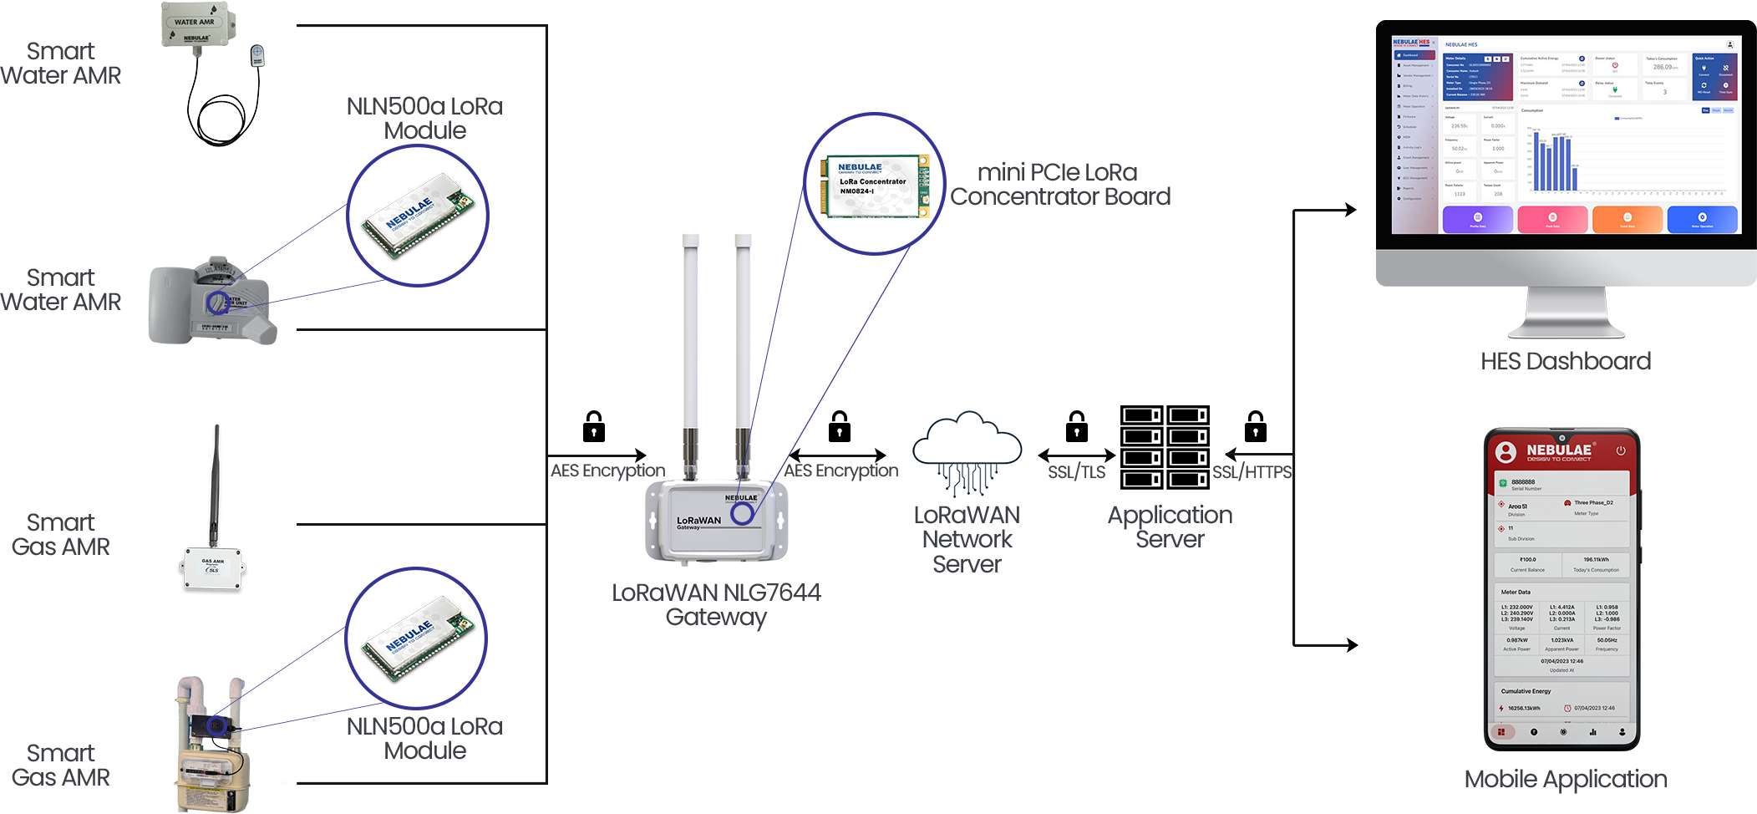
Water & Gas AMR Architecture

Slide 9
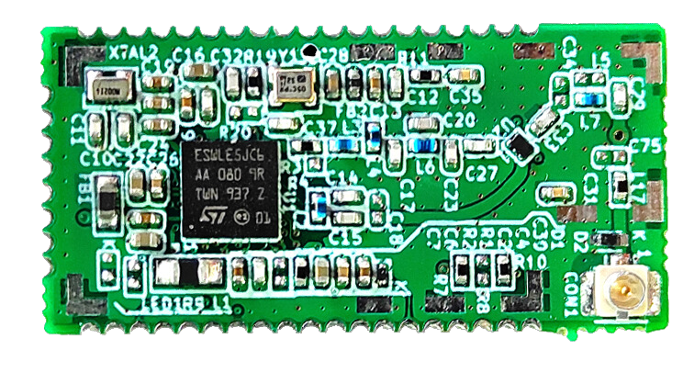
LoRa Module
NebuLink Node NLN500a is a compact and powerful Node for LoRa application. It is built on the STM32WL SoC which has Embedded LoRaWAN Transceiver for wide range of Smart Applications. It is useful when long range is required as it operates at 868 MHz & 915 MHz Band. It offers long range, low power and secure data transmission for M2M and IoT applications.
FEATURES
Frequency band: EU863-870 MHz, IN865 MHz
Sensitivity: Down to -135 dBm (SF12)
Serial Interfaces: 2 x SPI, 3 x I2C, 2 x USART, 1 x LPUART
Supports up to 43 Digital inputs and outputs
Analog inputs
Storage: 256 kB Flash and 64 kB RAM
RF interface optimize up to 50Ω
Output power level up to +20 dBm

Slide 10
LoRaWAN Gateway
NLG7644 gateway is pre-programmed with a full-featured LoRaWANTM network base station. It helps the LoRa devices to connect over 4G to the cloud. It has a range of over 15 km line-of-sight and over 2 km in dense urban environments. Its built-in GPS for location and timing makes it an ideal choice for remote LoRaWAN deployment.
FEATURES
Supports offline uplink LoRa packets storage up to 5000 packets
Open-source embedded Linux system
Supports Gateway bridge with TLS encryption
IP68, UL94 5VA flame and NMEA 4x rated case
Long range wireless data transmission
External fiber glass antenna with 5 dBi gain
Support of configurable State Packet

Slide 11
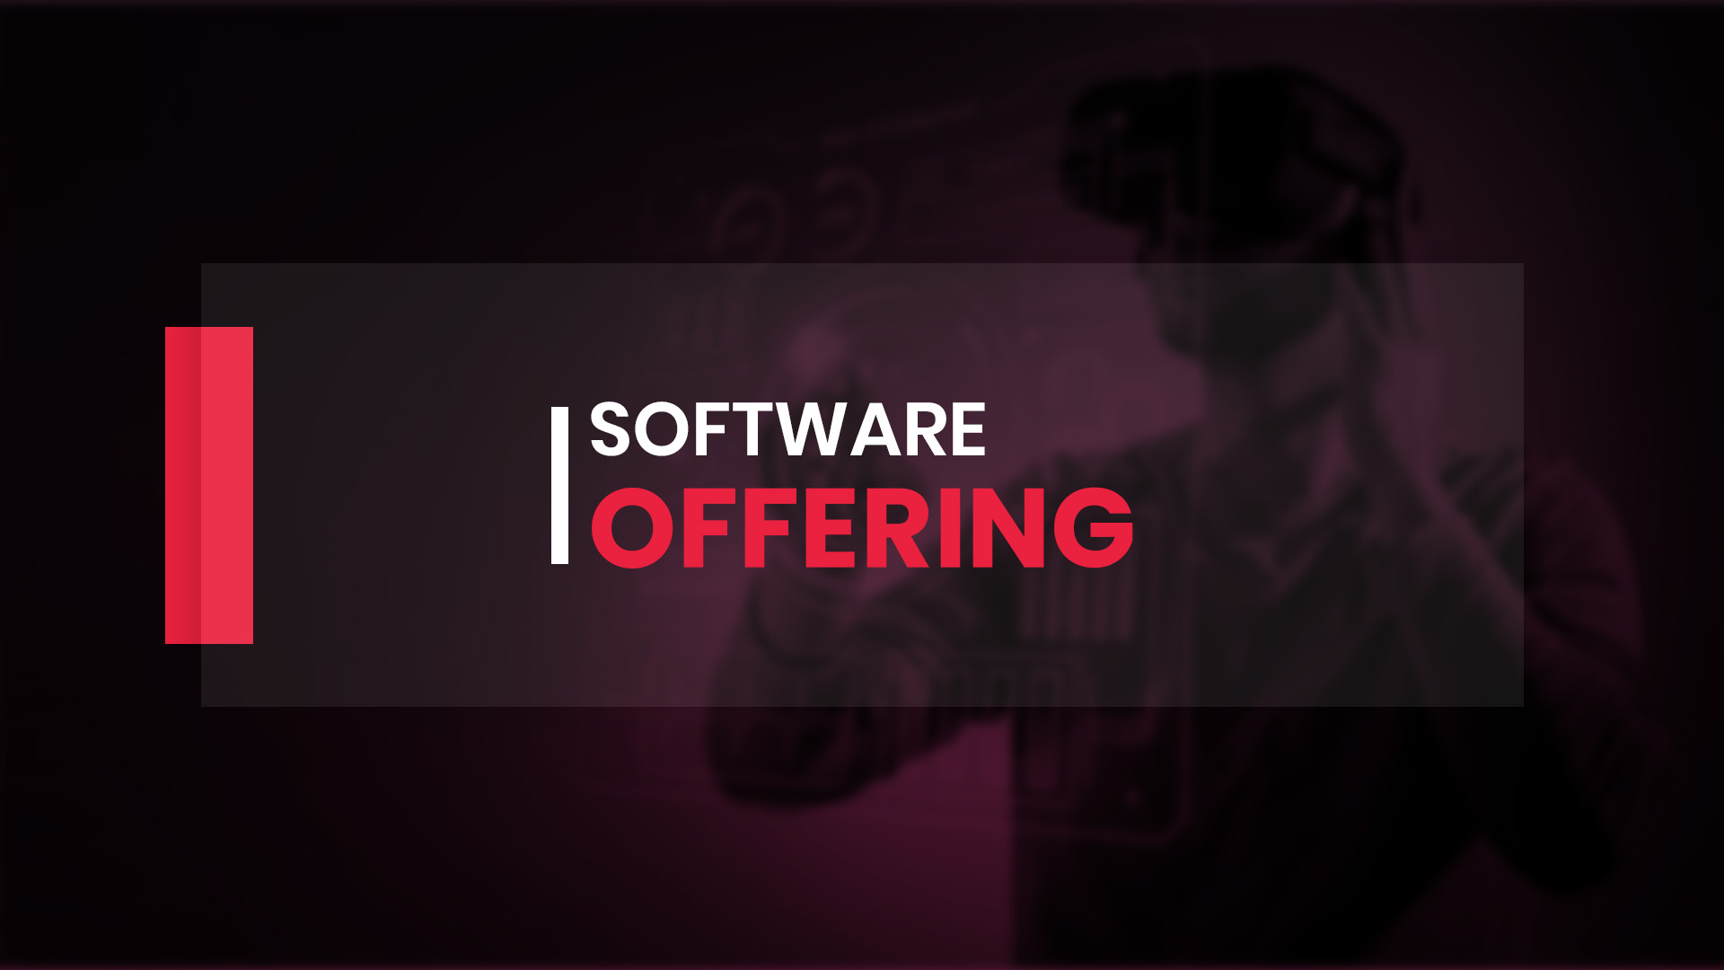

Slide 12

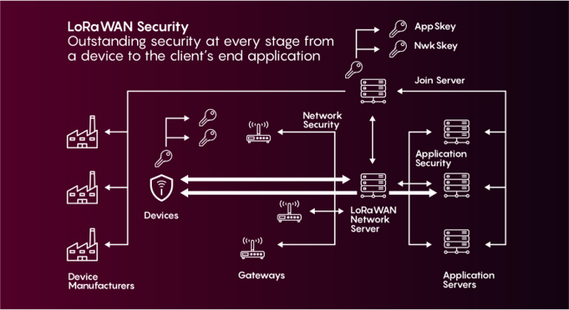
LoRaWAN Network Server (LNS)
Nebulae's LoRaWAN Network Server (LNS) is software for the operation and management of LoRaWAN networks. Nebulae's LNS enables connectivity, management, and monitoring of devices, gateways, and end-user applications. Its main objectives are to ensure the security, scalability, and reliability of data routing throughout the network with the maintenance of Low-Cost Deployment.
FEATURES
1.0x and 1.1x LoRaWAN versions
Supports A, B, and C device classes
Remote multi-cast
Third party output format integration
Geo-location
Secured communication with AES 128 and SSL/TLS
Public cloud, private cloud, as well as on-premise deployment options

Slide 13
Network Management Server (NMS)
Nebulae's LoRaWAN Network Server (LNS) is software for the operation and management of LoRaWAN networks. Nebulae's LNS enables connectivity, management, and monitoring of devices, gateways, and end-user applications. Its main objectives are to ensure the security, scalability, and reliability of data routing throughout the network with the maintenance of Low-Cost Deployment.
FEATURES
1.0x and 1.1x LoRaWAN versions
Supports A, B, and C device classes
Remote multi-cast
Third party output format integration
Geo-location
Secured communication with AES 128 and SSL/TLS
Public cloud, private cloud, as well as on-premise deployment options

Slide 14
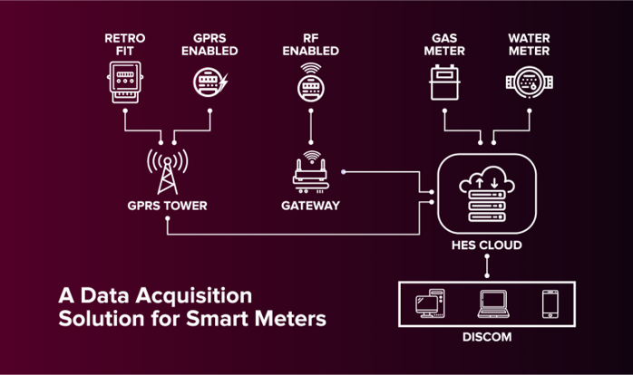
Head End System (HES)
HES for Smart Metering is our scalable Head End Data acquisition solution for Advanced Metering Infrastructure (AMI). The IoT-based solution monitors & controls smart meters operating as a communication driver between MDM Systems and measurement devices. The HES collects system-wide telemetry data & enables integration with smart energy devices with seamless interoperability, enhancing business intelligence, operational efficiency and system-wide remote device management.
FEATURES
Compatible with all meter types
Prepaid metering support
Displays collected data using GUI
Provides site-specific information
Prevents network overload
Uses standard connectors for popular ERP and billing systems
Designed to support IS 15959 and IS16444 global AMI standards for DLMS/COSEM

Slide 15
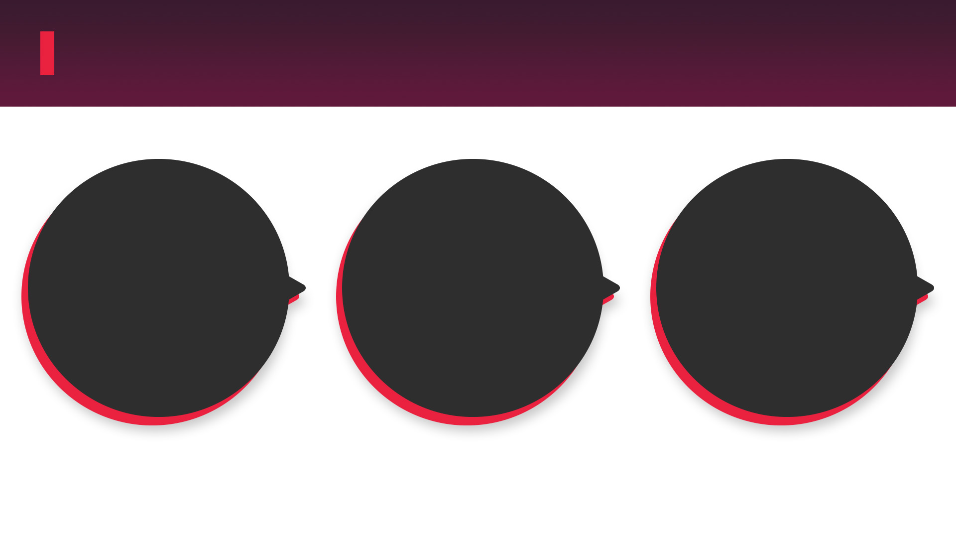
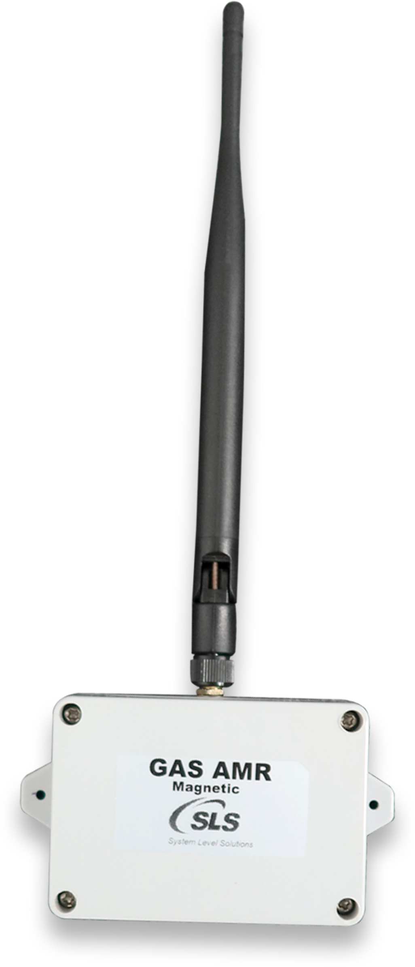
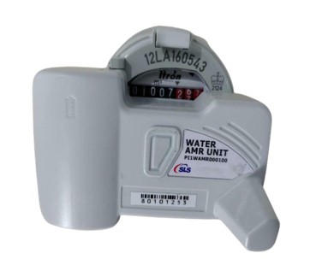
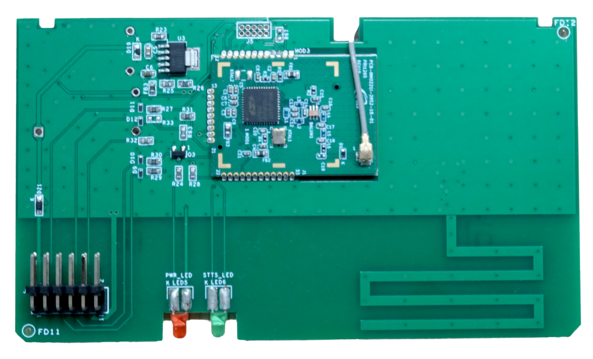
Use Cases
Water AMR
RF NIC Card
Gas AMR

Slide 16
